Slide 1

Category Code: Open Innovation
Problem Statement Title: Empowering Women Through a Centralized Digital Platform
Team Name: $ git commit -m "issues"
Institute Name: Vivekanand Education Society’s Institute of Technology

Slide 2

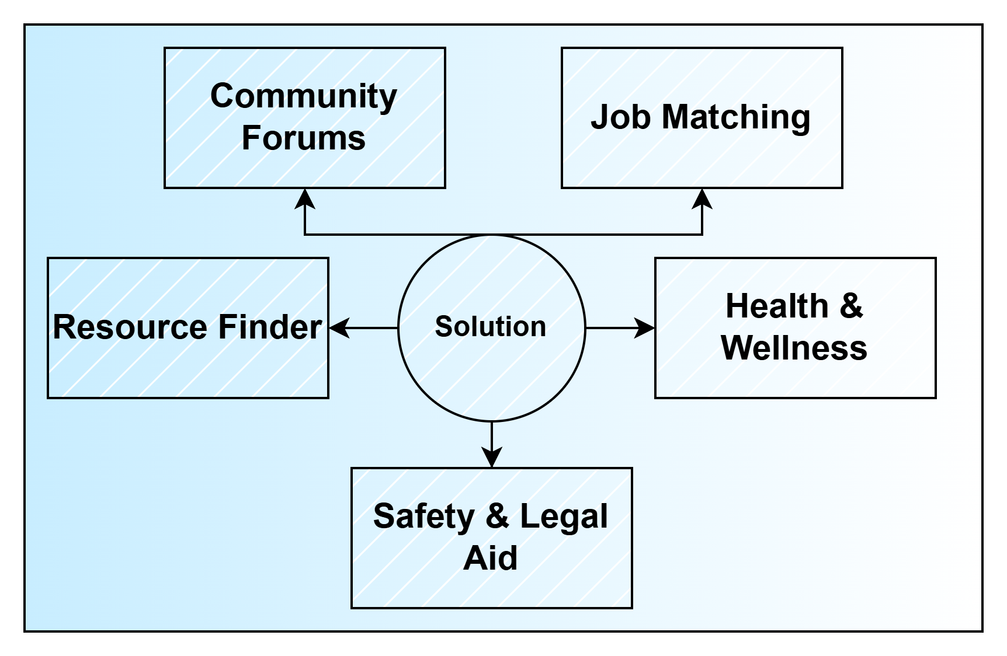
Idea / Approach details (& implemented features)
Astitva is an AI-driven platform empowering women by providing:
Community Forums – A safe space for discussions on career, health, safety, and legal matters.
Job Matching – AI-powered job recommendations for women-friendly workplaces.
Health & Wellness – Mental health support, cycle tracker, and well-being resources.
Safety & Legal Aid – Emergency alerts, self-defense tips, and legal guidance.
Resource Finder – Geolocation-based access to verified shelters, clinics, and legal support.
Target Audience
🎯 Women seeking jobs & financial independence 🎯 Survivors of abuse needing safety & legal help 🎯 Women requiring mental & physical health support 🎯 Young professionals & students 🎯 NGOs & organizations supporting women’s empowerment

Slide 3
What We Have Implemented ?
1️⃣ Job Marketplace A dedicated platform offering women-friendly job listings with search, filters, and category-based postings. Users can apply for jobs, save listings, and access career growth resources.
2️⃣ Health & Wellness Dashboard
Body Analysis: Calculates BMI and assesses health risks. Cycle Tracker: Predicts menstrual cycles based on user inputs.
Hydration Tracker: Monitors daily water intake with progress indicators.
Symptom Tracker: Logs health symptoms like headaches, cramps, and fatigue.
Activity Tracker: Tracks daily and weekly steps with visual analytics.
3️⃣ Community & Resource Finder
Discussion Forums: Space for knowledge sharing and networking.
Legal Aid & Emergency Contacts: Quick access to legal assistance and essential contacts.
Geolocation-based Safety Resources: Helps locate nearby shelters, medical centers, and legal aid services.
4️⃣ Security & Authentication
Firebase Authentication: Secure login using email/password & Google Sign-In.
Encrypted Communication: Ensures user privacy and protection, critical for sensitive discussions.
5️⃣ AI Chatbot Powered by Gemini AI, offering instant, accurate responses to legal, health, and career-related queries.

Slide 4
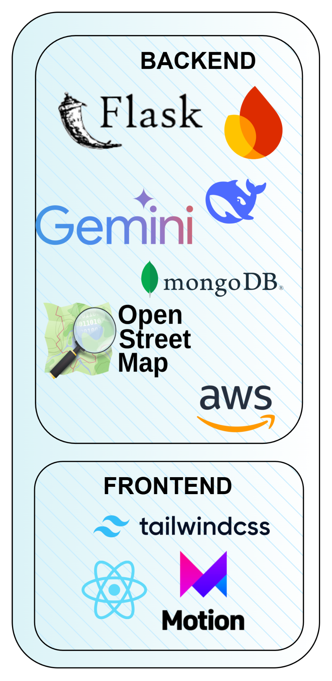
Innovation & Tech Stack
Astitva is an all-in-one platform empowering women by integrating safety, employment, health, and community support.
🔹 AI-Powered Chatbot – Built with Gemini AI, offering 90% accurate responses to legal, health, and career queries. 🔹 Job Finder – Helps women find jobs tailored to their skills, preferences, and work conditions (remote, part-time, women-friendly workplaces). 🔹 Encrypted Privacy – Ensures secure communication with end-to-end encryption and IP masking for sensitive issues like domestic violence. 🔹 Real-time Mapping – OpenStreetMap integration provides real-time access to 200+ essential resources in 5 cities.

Slide 5
Architecture
System Architecture of Astitva
🖥 Frontend (Client-Side)
Built with React.js for a seamless user experience.
Tailwind CSS & Material UI for an intuitive and accessible UI.
🤖 AI & Data Processing
Gemini AI-powered Chatbot for instant responses on health, legal aid, and career queries.
ML Models analyze user data for personalized job & wellness recommendations.
🔒 Security & Privacy
End-to-End Encryption for private and anonymous communication.
IP Masking ensures user safety in high-risk situations.
🌍 Third-Party Integrations
OpenStreetMap for geolocation-based emergency services.

Slide 6
Future Scope
Future Scope of Astitva
🚀 AI & Personalization
Enhance AI chatbot with advanced NLP for more precise legal, health, and career guidance.
Personalized dashboards based on user behavior and preferences.
📈 Expanded Job Opportunities
Integrate AI-driven job recommendations for tailored career opportunities.
Collaborate with women-focused organizations for better employment support.
🌍 Geographical Expansion
Scale resource mapping to more cities & rural areas for wider accessibility.
Multi-language support for diverse user groups.

